Slide 1


CSST106 - Perception and Computer Vision
Machine Problem 1
Introduction to Computer Vision and Image Processing
PRESENTED BY: LESLY-ANN B. VICTORIA
Instructor: Sir Mark P. Bernardino
BSCS-4B

Slide 2


CSST106 - Perception and Computer Vision
Machine Problem 1
Computer Vision and Image Processing
Computer Vision
A branch of computer science that empowers machines to see, recognize and process images just like humans.
A field of AI that enables computers to interpret and make decisions based on visual data, such as images and videos.
It uses artificial intelligence and machine learning (AI/ML) to process this data accurately for object identification and facial recognition, as well as classification, recommendation, monitoring, and detection.
How AI Systems Process Visual Information
AI systems use computer vision algorithms to process visual information. The process involves capturing images through sensors or cameras, pre-processing these images to enhance their quality, and then using models and algorithms to analyze the visual data.
Role of Image Processing in AI systems
AI image processing uses artificial intelligence to analyze and enhance images.
It involves tasks like pattern recognition, object detection, and image classification.
Core technologies include deep learning, neural networks, and machine learning algorithms.
Revolutionizes healthcare, security, and entertainment by automating complex tasks and improving accuracy.

Slide 3

CSST106 - Perception and Computer Vision
Machine Problem 1
Types of Image Processing Techniques
Filtering
A technique used to enhance the quality of images.
It involves the application of mathematical operations to an image to extract important features, remove noise, or blur images.
Example: A Gaussian filter can smoothen an image, removing unwanted noise, while sharpening filters can enhance the edges and details in an image.
Edge Detection
A technique used for identifying and locating the boundaries or edges of objects in an image.
It is used to identify and detect the discontinuities in the image intensity and extract the outlines of objects present in an image.
Example: Canny Edge Detection, Sobel Edge Detection, Laplacian Edge Detection, Prewitt Edge Detection
Segmentation
A technique used to separates objects, boundaries, or structures within the image for more meaningful analysis.
It involves partitioning a digital image into multiple segments (regions or objects) to simplify and analyze an image by separating it into meaningful components.
Example: Object Detection, Medical Imaging and Image Recognition

Slide 4
CSST106 - Perception and Computer Vision
Machine Problem 1
Case Study Overview
AUTONOMOUS VEHICLES
A driverless vehicle, is one that is able to operate itself and perform necessary functions without any human intervention, through ability to sense its surroundings.
Utilizes a fully automated driving system in order to allow the vehicle to respond to external conditions that a human driver would manage.
How Image Processing used in AUTONOMOUS VEHICLES
Autonomous vehicles rely heavily on image processing to navigate and make real-time decisions.
The use of cameras and sensors to capture images of their surroundings, which are then processed using computer vision techniques. These techniques help the vehicle detect obstacles, recognize traffic signs, identify lanes, and interpret road conditions.
The images captured from the autonomous car are processed by the proposed system which is used to control the autonomous vehicle.
PROBLEM: Lane Detection in Autonomous Vehicles

Slide 5
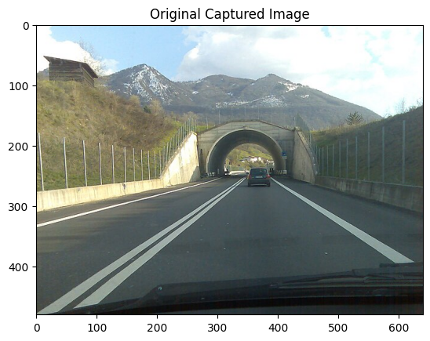
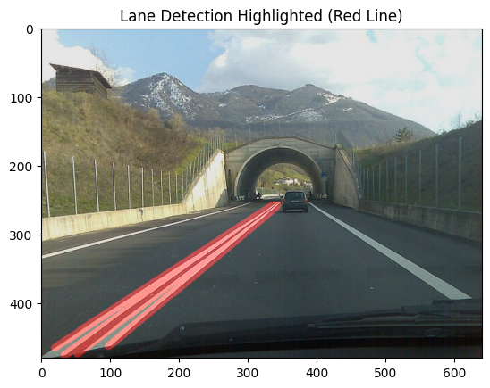
CSST106 - Perception and Computer Vision
Machine Problem 1
My Image Processing Implementation
Problem in autonomous vehicles is detecting the lane boundaries to ensure the vehicle stays within its lane. Edge detection is a key technique used to solve this problem.
I use Canny Edge Detection technique to detect lane boundaries in captured image from the car.
The lane detection model helps the AI system keep the vehicle within its lane, plan safe paths, and navigate efficiently, enhancing overall driving safety.

Slide 6

CSST106 - Perception and Computer Vision
Machine Problem 1
Conclusion
The document underscores the importance of effective image processing in Artificial Intelligence (AI) as it enables AI systems to accurately interpret and analyze visual data. Techniques such as filtering, edge detection, and segmentation are vital in extracting meaningful information from images, which is essential for AI applications like autonomous vehicles, facial recognition, and medical imaging. In the case study on autonomous vehicles, the practical implementation of Canny Edge Detection demonstrated how image processing helps in ensuring lane detection, thereby enhancing driving safety.
From this activity, I learned that effective image processing is foundational to the success of AI systems. It allows AI to perform complex tasks, such as object detection and scene understanding, with high precision. The hands-on experience of implementing edge detection for lane detection in autonomous vehicles highlighted how these techniques are applied in real-world scenarios, reinforcing the critical role of image processing in advancing AI technologies.

Slide 7



CSST106 - Perception and Computer Vision
Machine Problem 1
Deep Learning Based Image Analysis
Deep learning uses neural networks to learn useful representations of features directly from data. For example, you can use a pre-trained neural network to identify and remove artifacts like noise from images.
Deep Learning-Based Image Analysis is a major step forward in image processing, enabling AI to learn and improve its ability to analyze images directly from data.
This approach increases the accuracy and efficiency of AI systems, making them more useful in different fields like healthcare, security, and self-driving cars.
Potential Impact on Future AI Systems
The potential impact of this technique is immense, as it can greatly expand how AI can be applied to solve challenging visual tasks. For example, in my image processing implementation of lane detection in autonomous vehicles, the enhanced ability to process and interpret complex visual environments could make self-driving cars safer and more reliable, bringing us closer to widespread adoption.

Slide 8


CSST106 - Perception and Computer Vision
Machine Problem 1
THANK YOU!
A computer is like a violin. You can imagine it, making beautiful music, but you have to learn how to play it.
-Bill Gates
Instructor: Sir Mark P. Bernardino
BSCS-4B

